Slide 1
ECE 313: PROBABILITY WITH ENGINEERING APPLICATIONS
Fall 2023
Prof. Eric Chitambar
Lecture 16

Slide 2

Cumulative Distribution Function (cdf)

Slide 3


Cumulative Distribution Function (cdf)

Slide 4
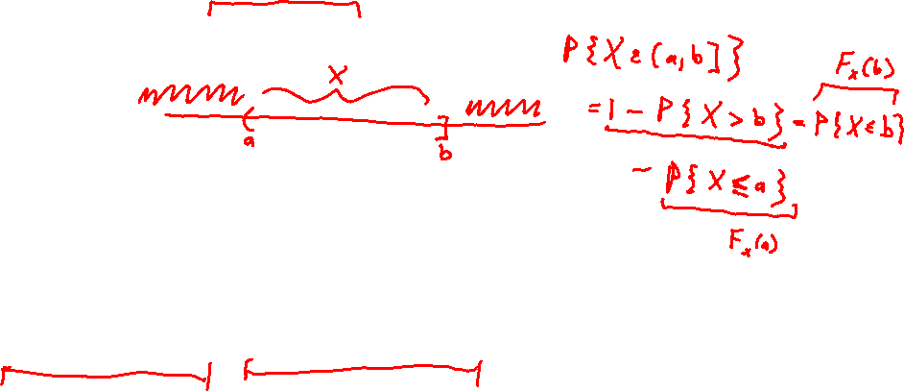
Cumulative Distribution Function (cdf)

Slide 5





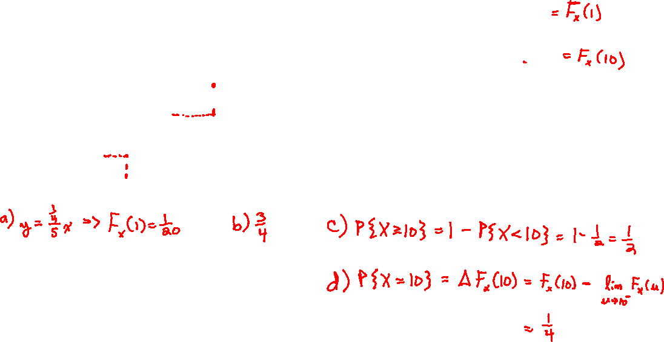
Cumulative Distribution Function (cdf)

Slide 6





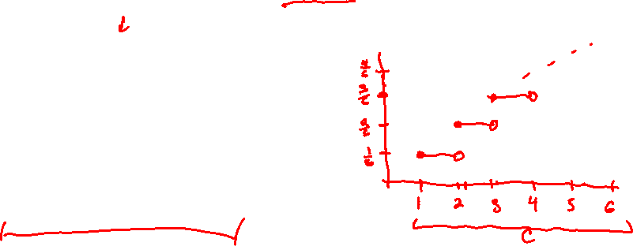
Cumulative Distribution Function (cdf)

Slide 7


Probability Distribution Function (pdf)

Slide 8



Probability Distribution Function (pdf)

Slide 9




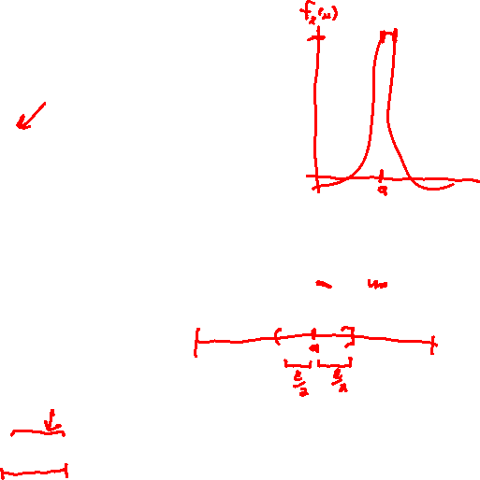
Probability Distribution Function (pdf)

Slide 10

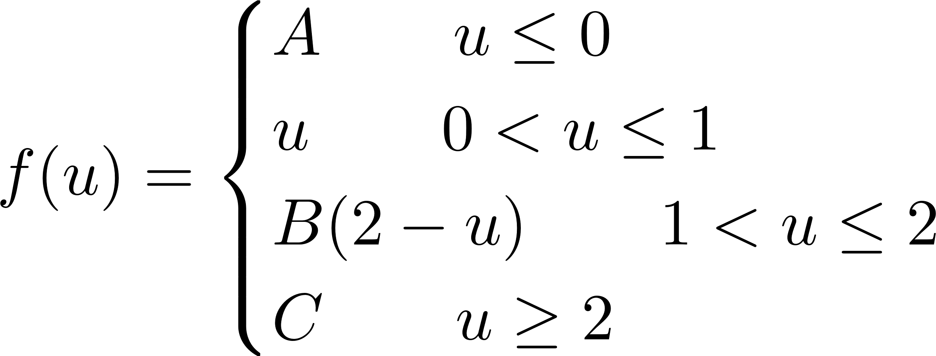

Probability Distribution Function (pdf)

Slide 11
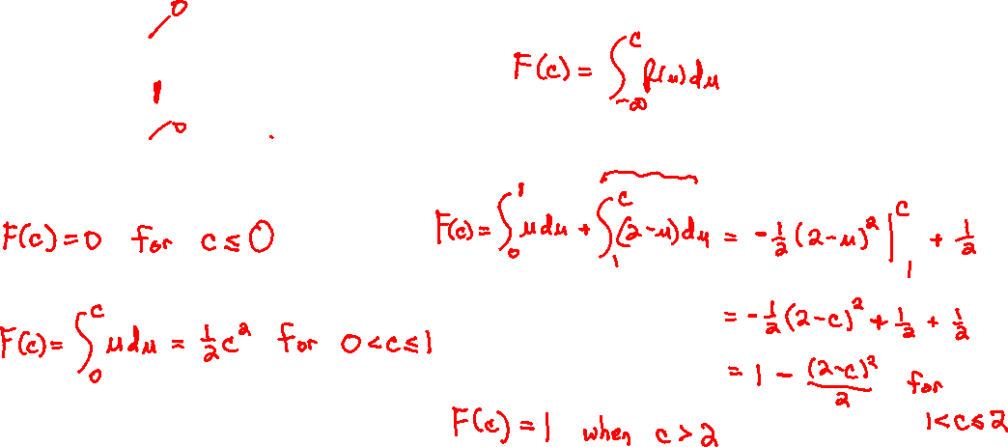
Probability Distribution Function (pdf)

Slide 12



Probability Distribution Function (pdf)

Slide 13



The Uniform Distribution

Slide 14

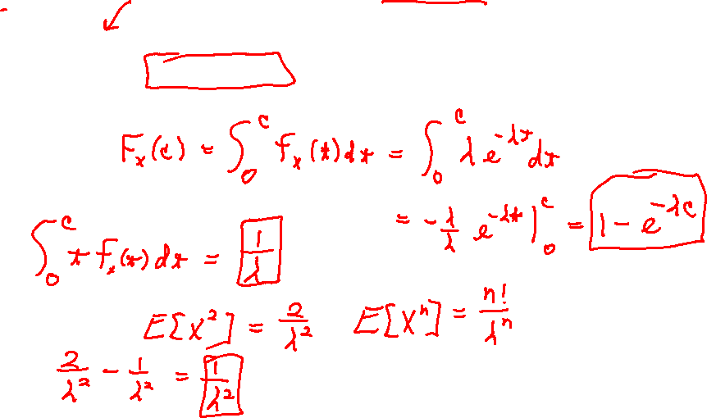
The Exponential Distribution

Slide 15
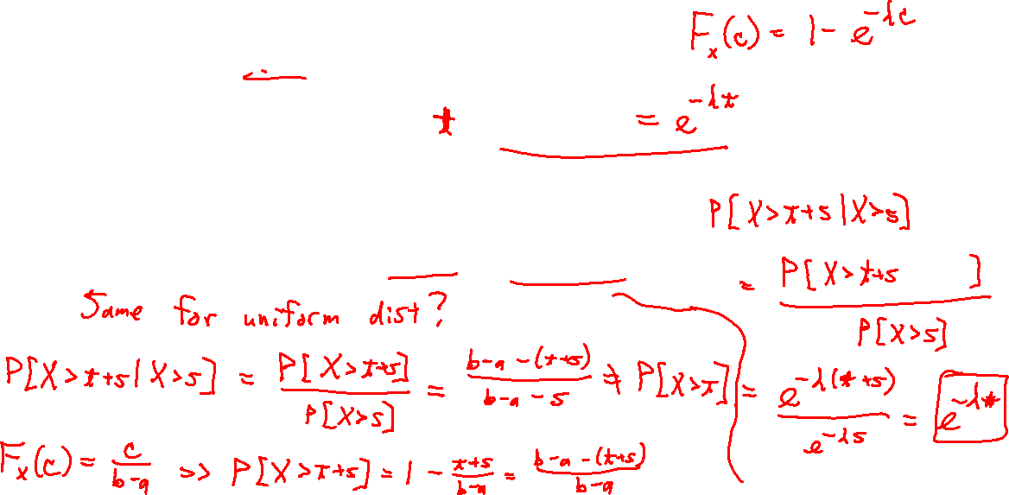
The Exponential Distribution

